Slide 1
Socio-Economic Business Model
Pay iT Forward

Slide 2
Pay it Forward
Credits are awarded for folks who provide their time & knowledge to fellow members.
Debits are assigned for folks who consume time & knowledge from fellow members.
A Debit-balance is acceptable for startups or folks in transition.
Folks with significant credit balances should be recognized by the members and local chambers.

Slide 3
Platforming Value
Getting your first customer
Measuring Value
Building Your Portfolio
Improving Your Messaging
Here’s what we can provide
Growing Your Business
Protecting Your IP
Entering New Markets
Creating a Transition Plan
Repurposing Your Skills
Deciding When to Get Help
Bringing Aboard New Talent
Incorporating New Products
Generating Ideas for Improving Your Products & Services
Collaborating with Members
Finance
Legal
Here’s what we can leverage
Tech
Marketing
Comm
Strategy
Entrepre-neurs

Slide 4
Create Community Hubs
Strategy
Communi-
cations
Innovation
Technology
Product / Service Dev.
Coaching
Mentoring
Service Augmentation
Skill Building

Slide 5
Learn & Improve the Model
Identify which areas we can develop hubs for collaborative offerings to help the community and individual business owners.
Identify roles for unemployed individuals to contribute and gain visibility.
Identify opportunities to assist small business owners & early stage entrepreneurs. *
* Not an incubator…only offering guiding & mentoring

Slide 6
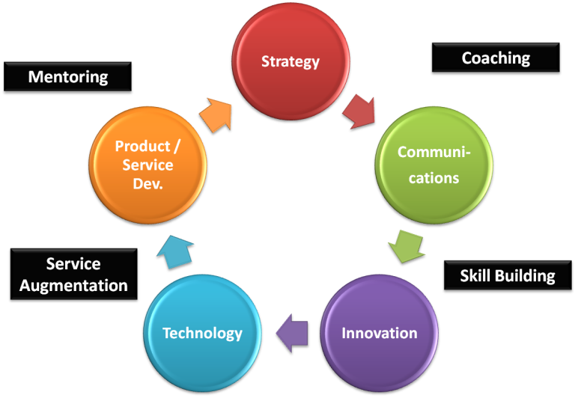
Expand to Other Communities
Evanston
Naperville
Others…

